Slide 1
University Management System
Developed By
YODA Super Kings

Slide 2

Agenda
Overview
Brainstorming Objectives
Software Used
Team Members
Project Architecture
System Architecture
Flow Chart
Workflow Screen
Testcase Link
Future Scope
Conclusion

Slide 3

Overview
Develop portal for university
Student Admission Process
Certificate Verification by the University
Separate User Creation for the University, Staff, Students
Schedule Examination for the Academic year
Manage Fee Payments
Publish Examination Results
Publish Certificates

Slide 4

Brainstorming Objectives
University looking for single platform for handling all the activity of Student and the university.
Addressing University Management System ,So that the University and Student can save time which is convenient for both university and students

Slide 5

Technology Used
React JS
MongoDB 6.0.4
API core
VS Code v1.74.3
Dot Net-SDK 3.1.426
Visual Studio v16.11.33214

Slide 6


OUR Team
DEV
Chiranjeevi Lokeshwaren
Muthukumar Balakrishnan
Suriya Velayutham
QA
Megala Kabali

Slide 7
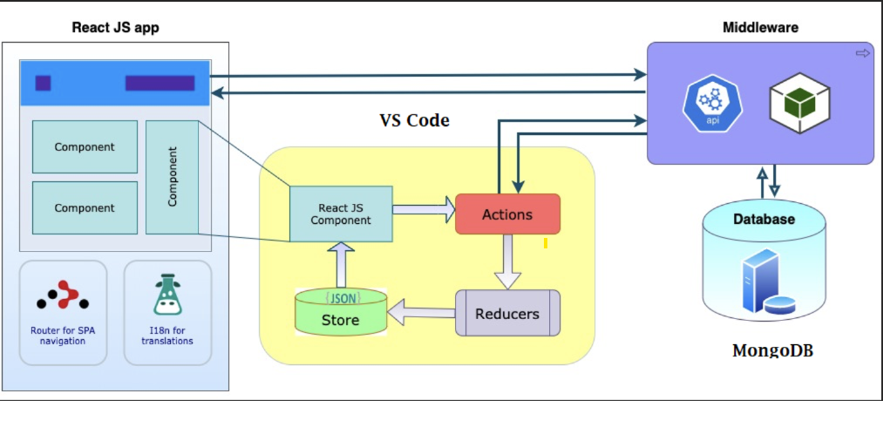
Project Architecture

Slide 8
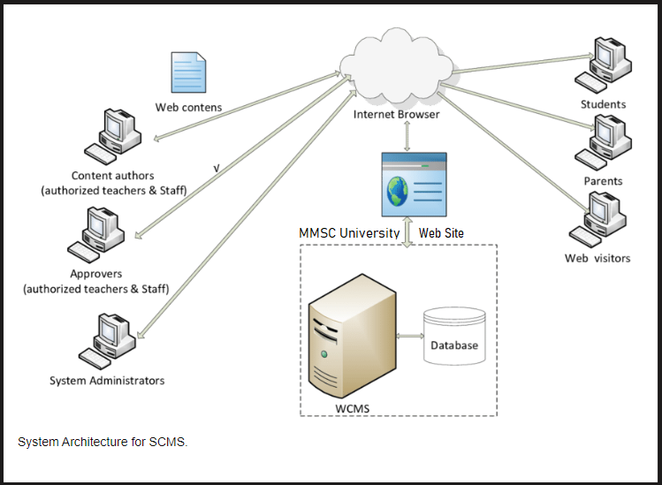
SYSTEM Architecture

Slide 9
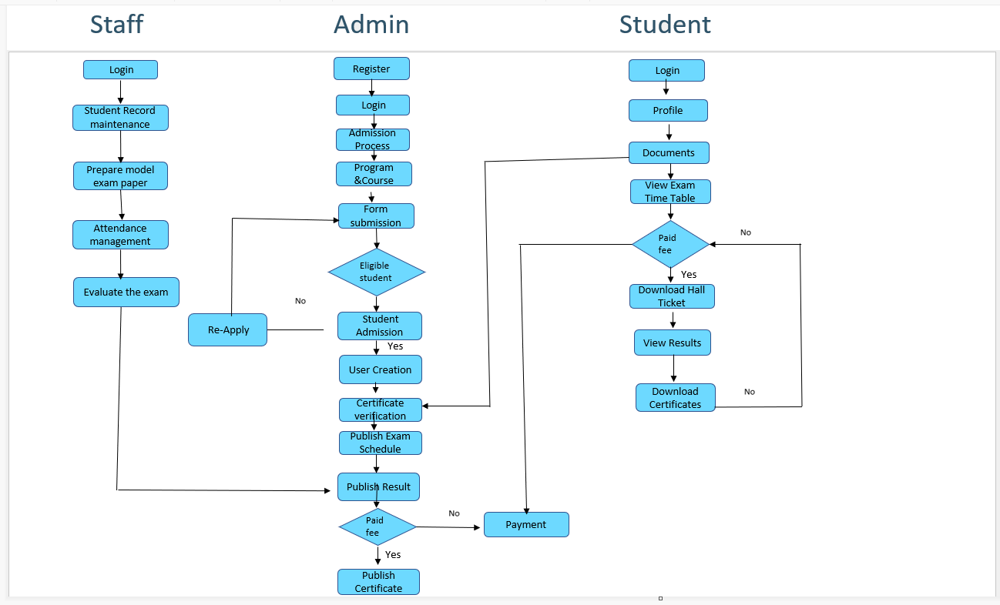
FLOW CHART

Slide 10

MODULES
Administration
Admission
Accounts
Certificate Verification
Department Information
Course
Infrastructure
Syllabus
Staff Information
Profile
Maintain Student Details
Attendance
Model Paper preparation
Exam Evaluation

Slide 11
MODULES (cONTD.)
Student Information
Profile
Document
View Time Table
Download Hall Ticket and Certificates
Payment History
Examination
Schedule
Attendance

Slide 12
Welcome to CMS Screens

Slide 13
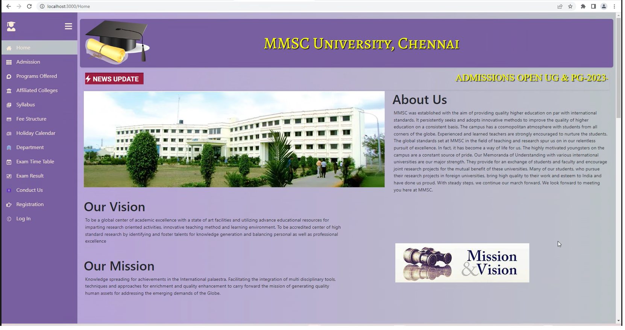
HOME PAGE

Slide 14
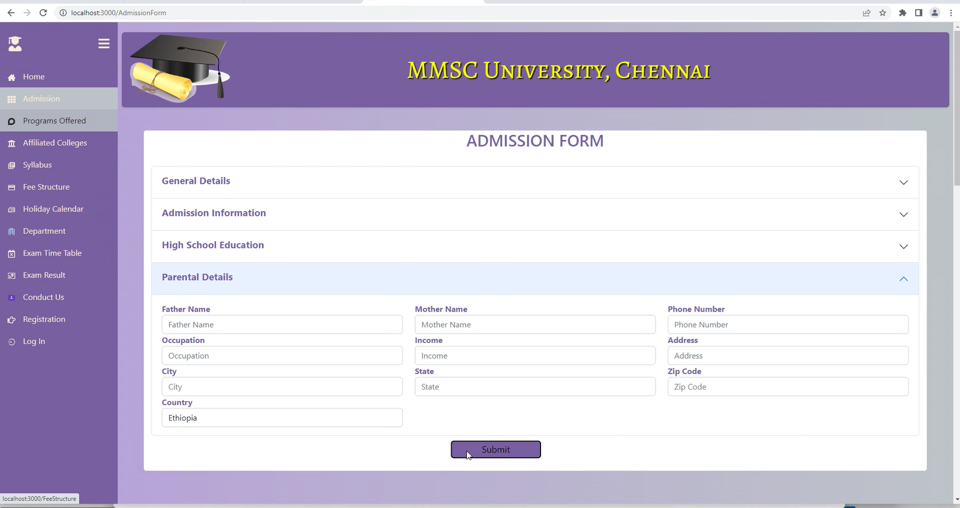
Application form

Slide 15
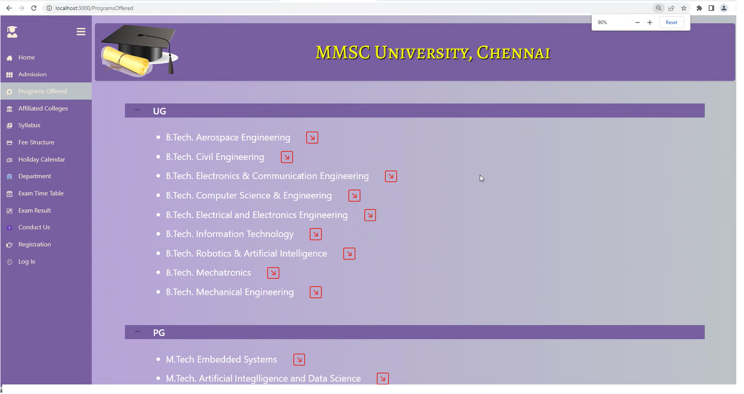
Programs Offered

Slide 16
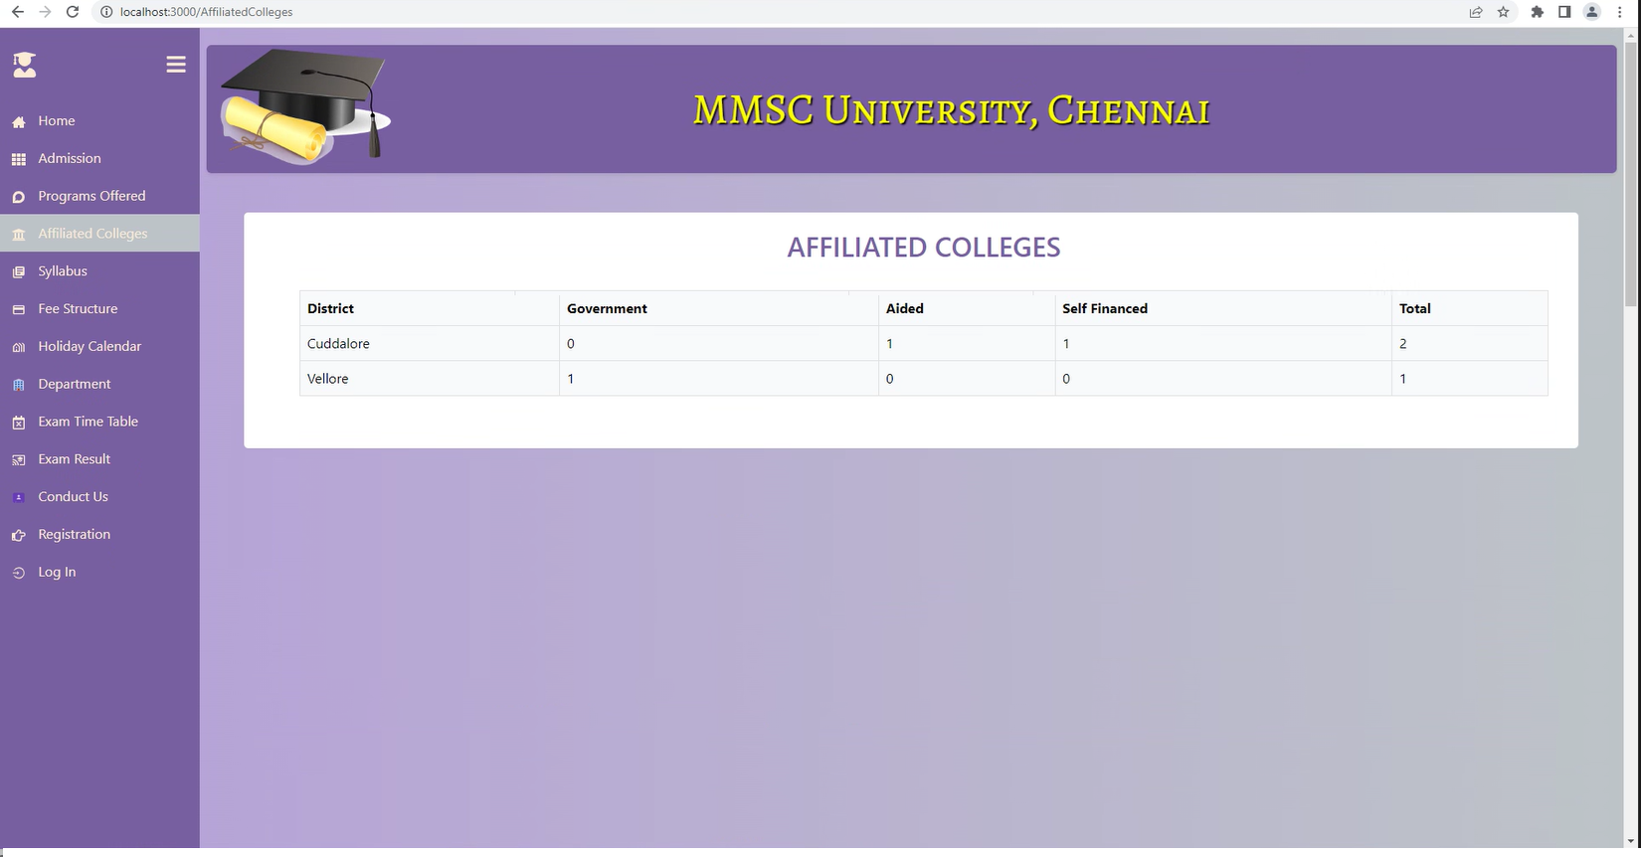
Affiliated college

Slide 17
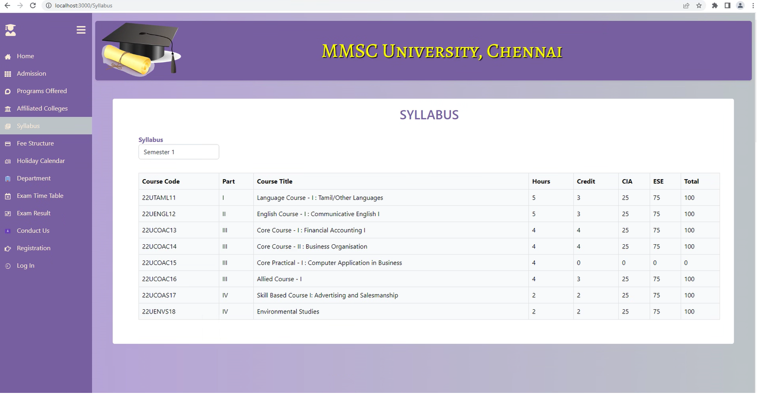
syllabus

Slide 18
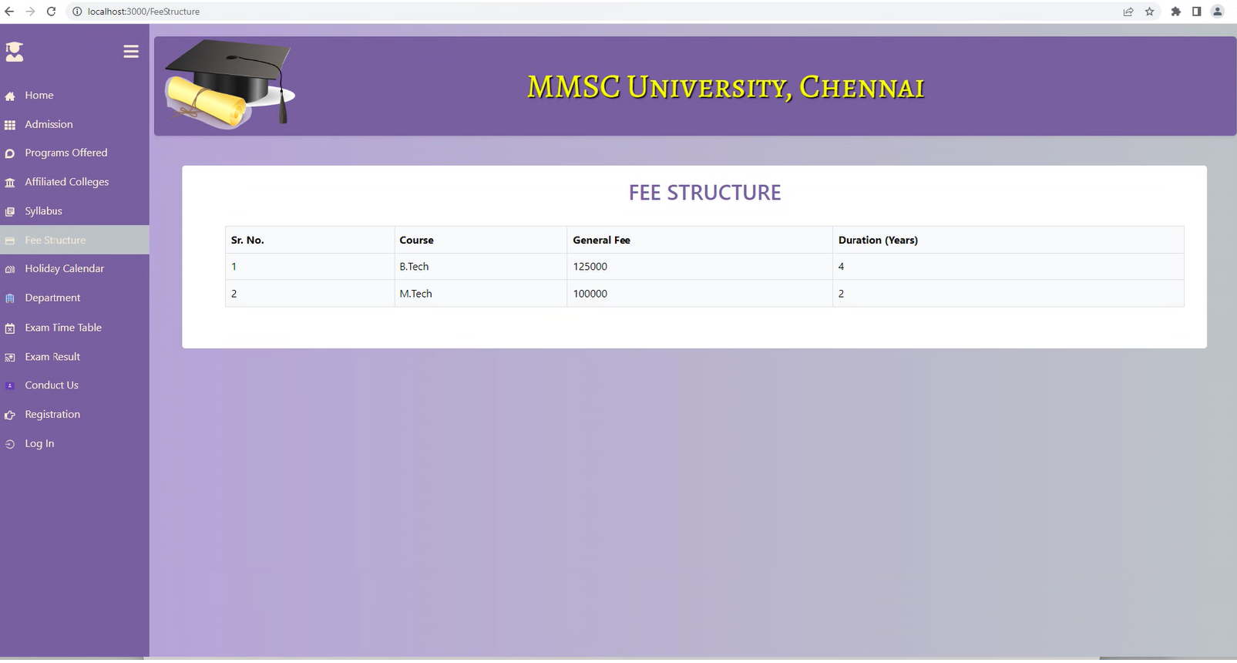
Fee structure

Slide 19
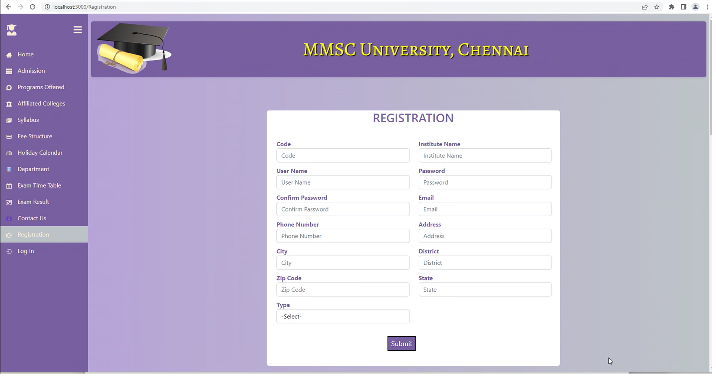
College Registration

Slide 20
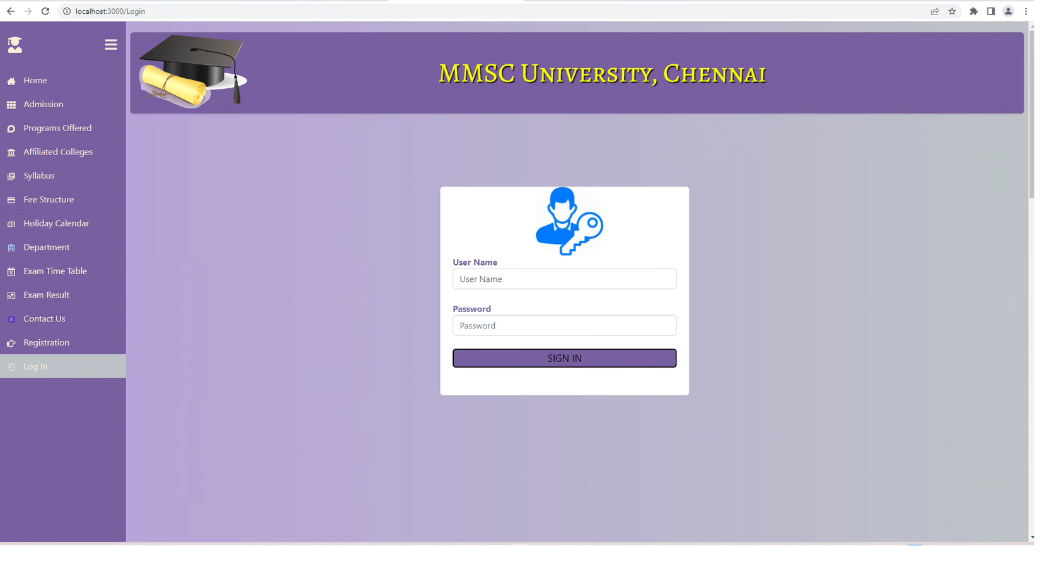
Login screen

Slide 21
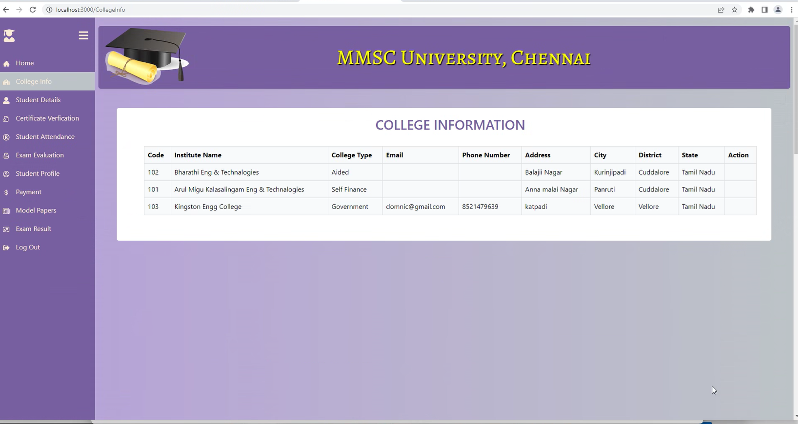
College information (University Admin)

Slide 22
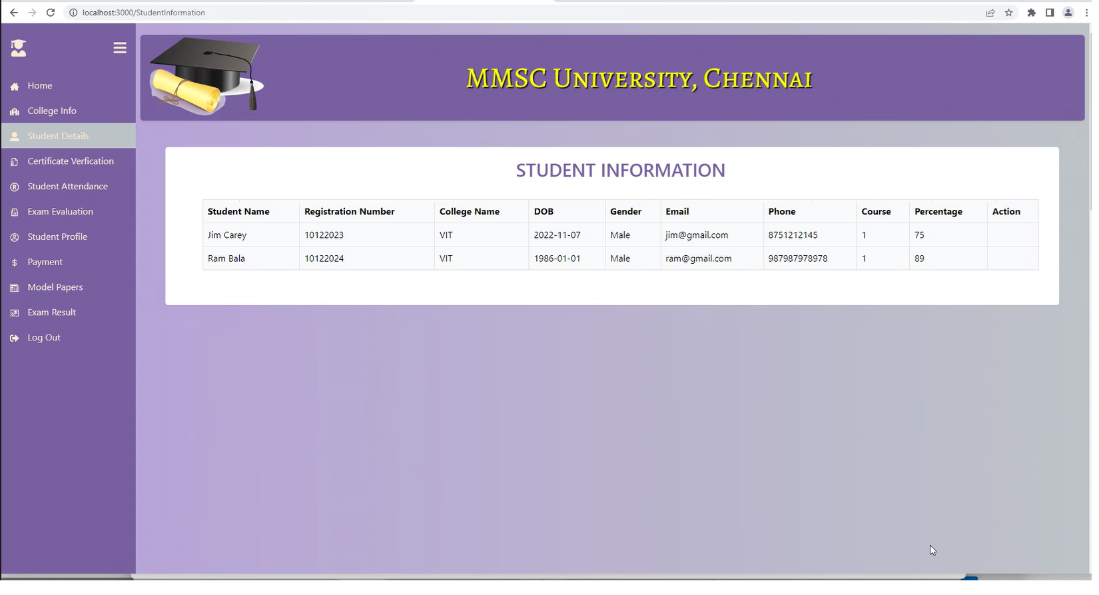
Student Details

Slide 23
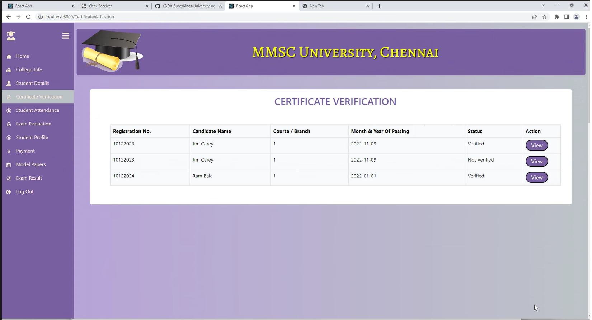
Certificate verification

Slide 24
Certificate verification

Slide 25
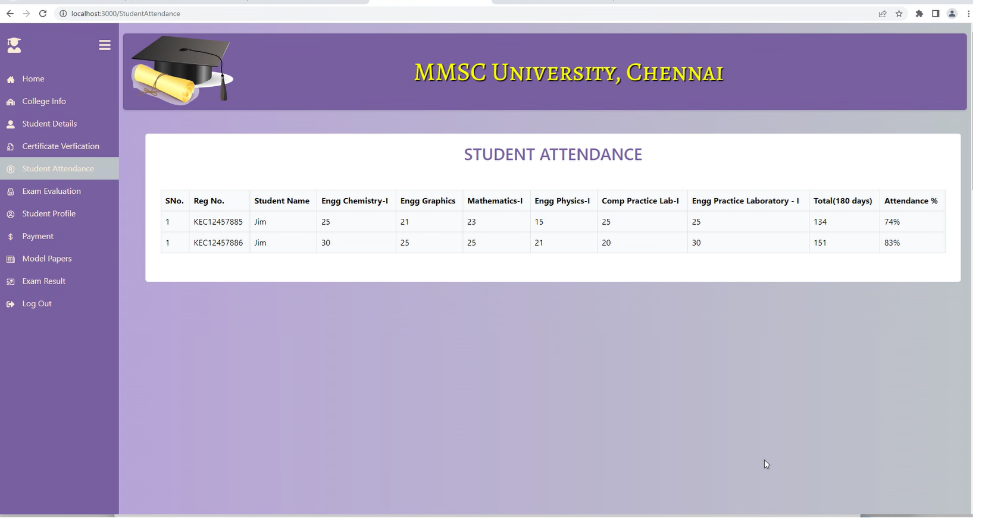
Student Attendance management

Slide 26
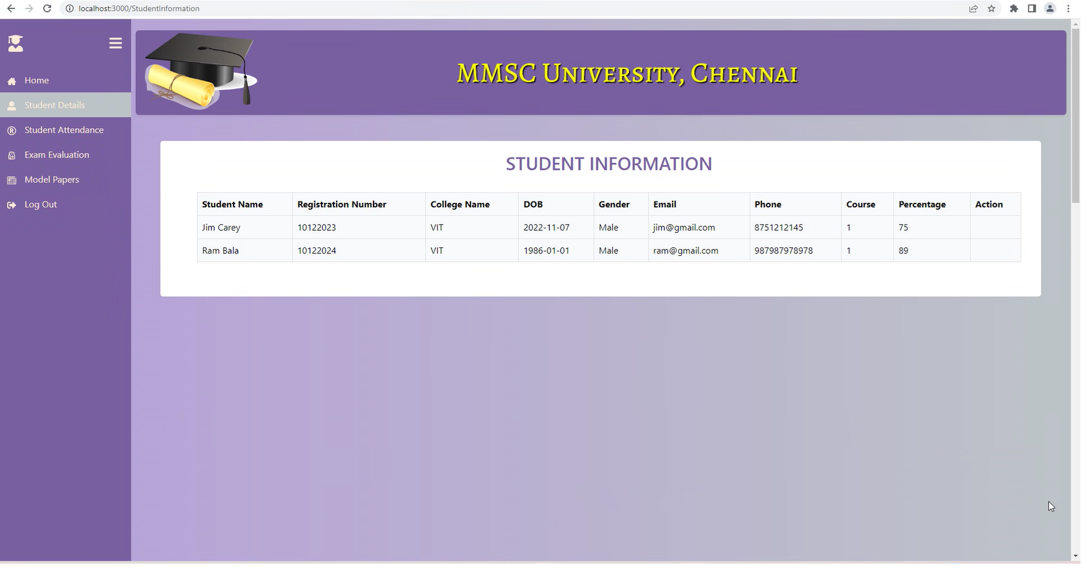
Student details (College staff login)

Slide 27
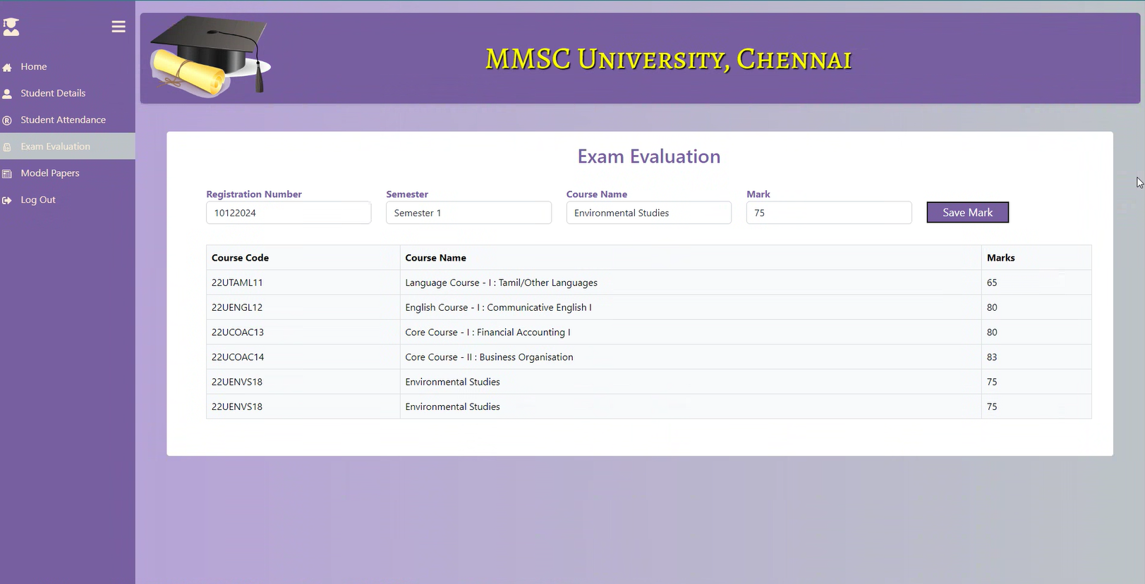
Exam Evaluation

Slide 28
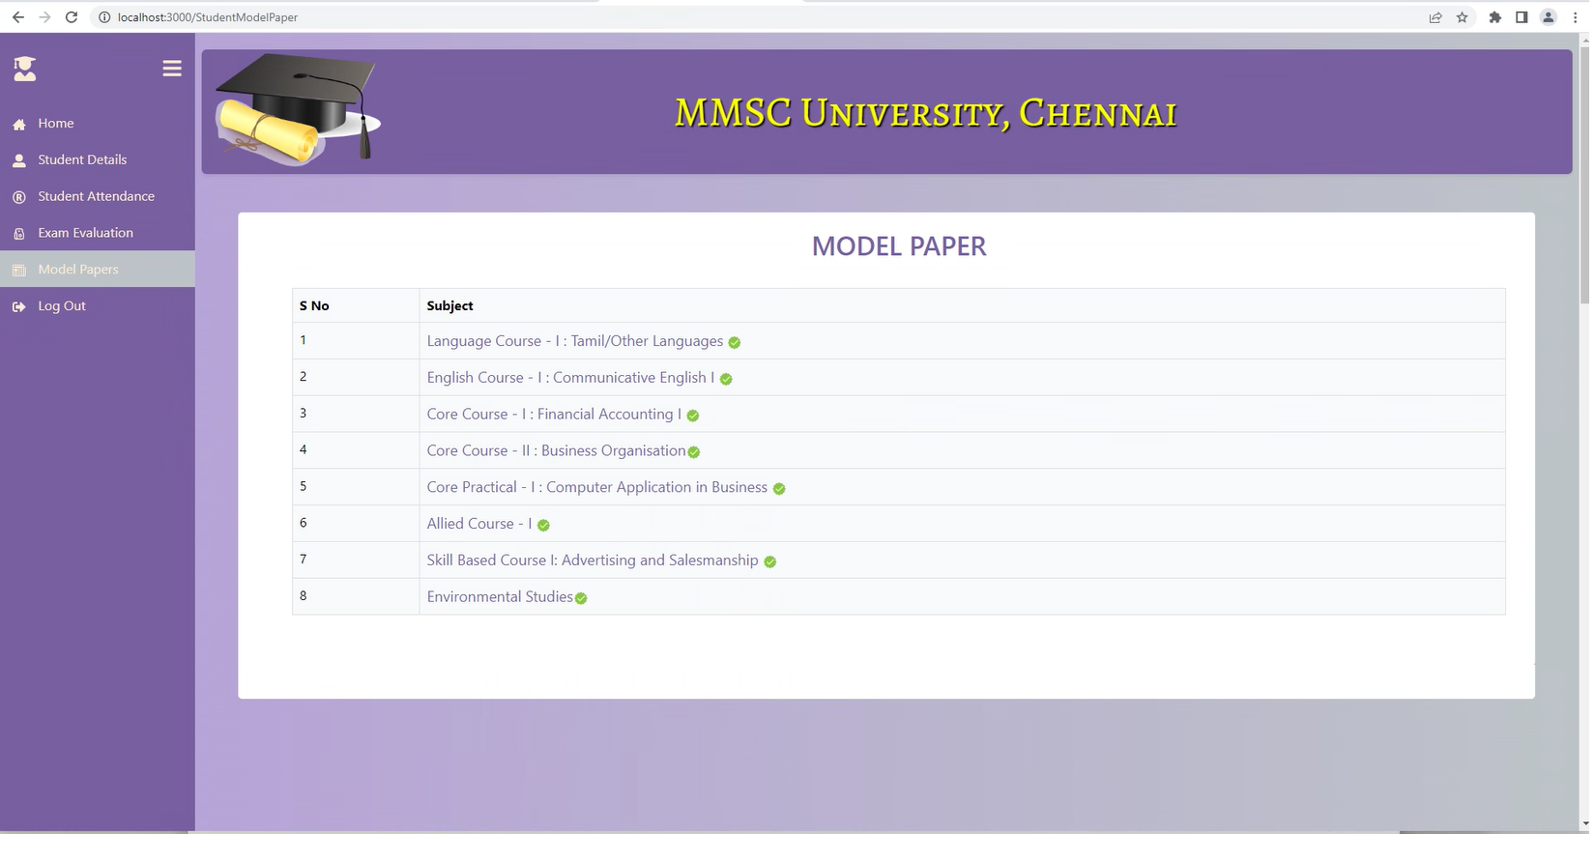
Model Papers

Slide 29
Student Login

Slide 30
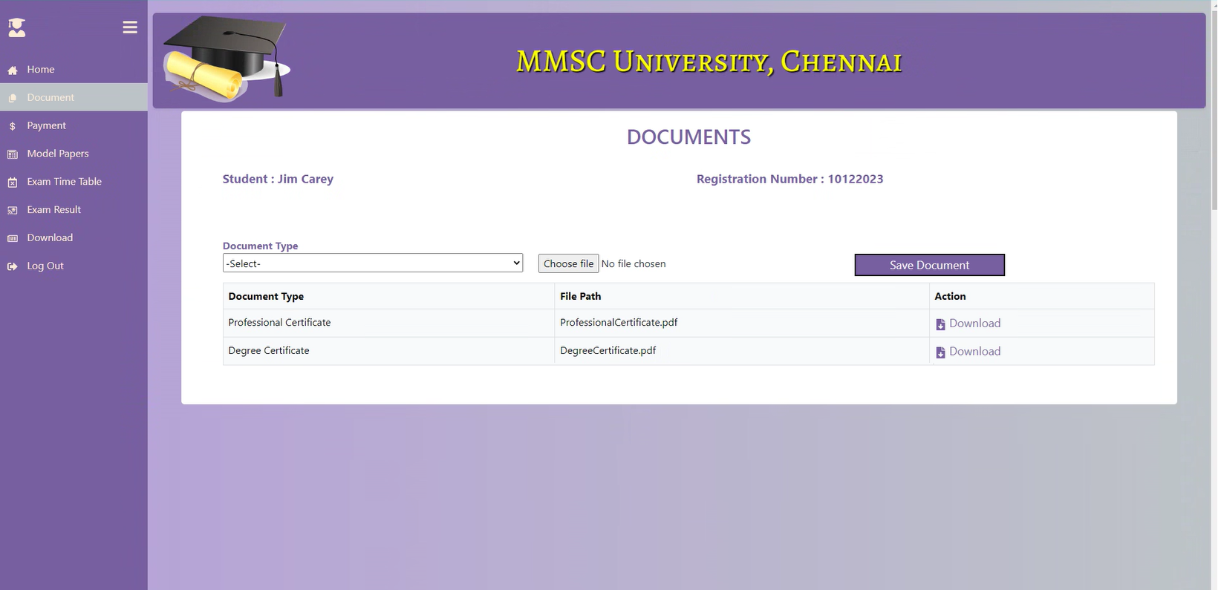
Documents

Slide 31
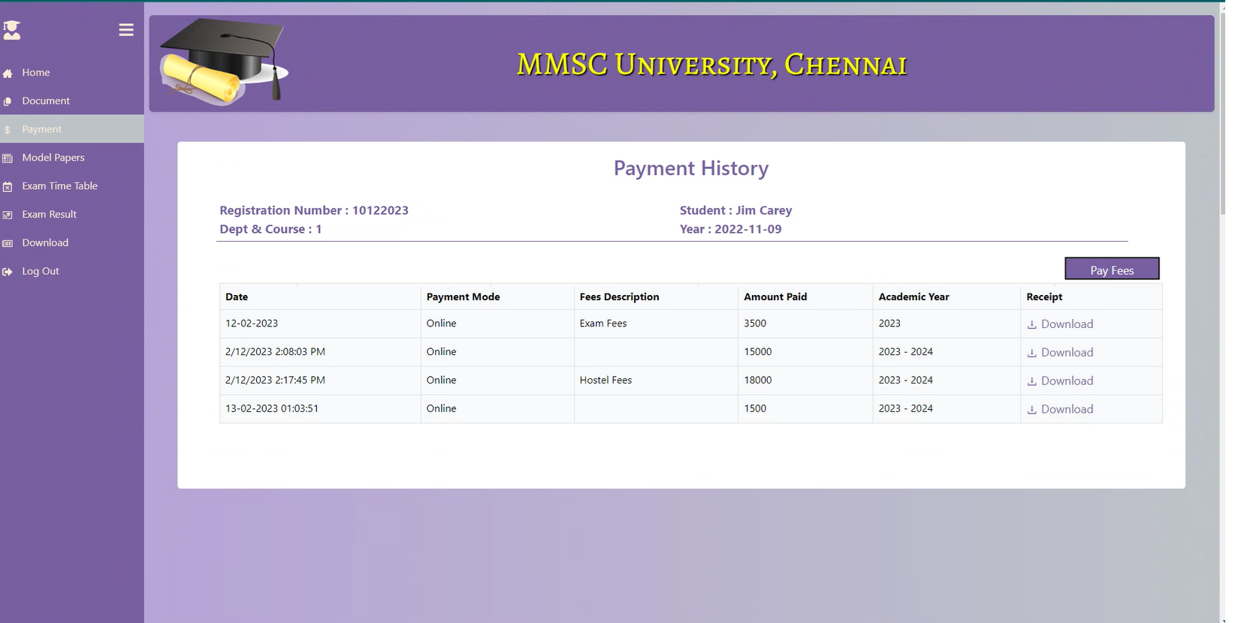
Payment History

Slide 32
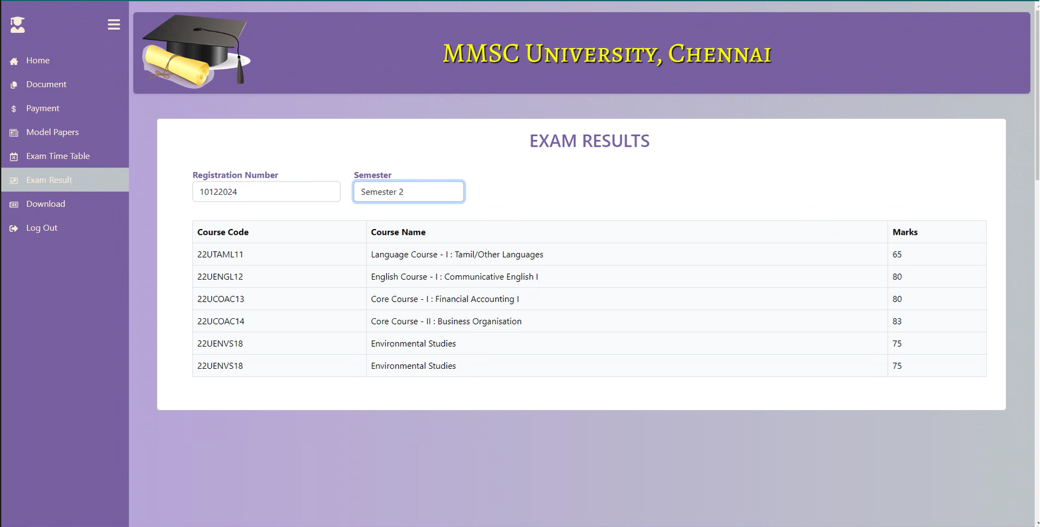
Exam results

Slide 33
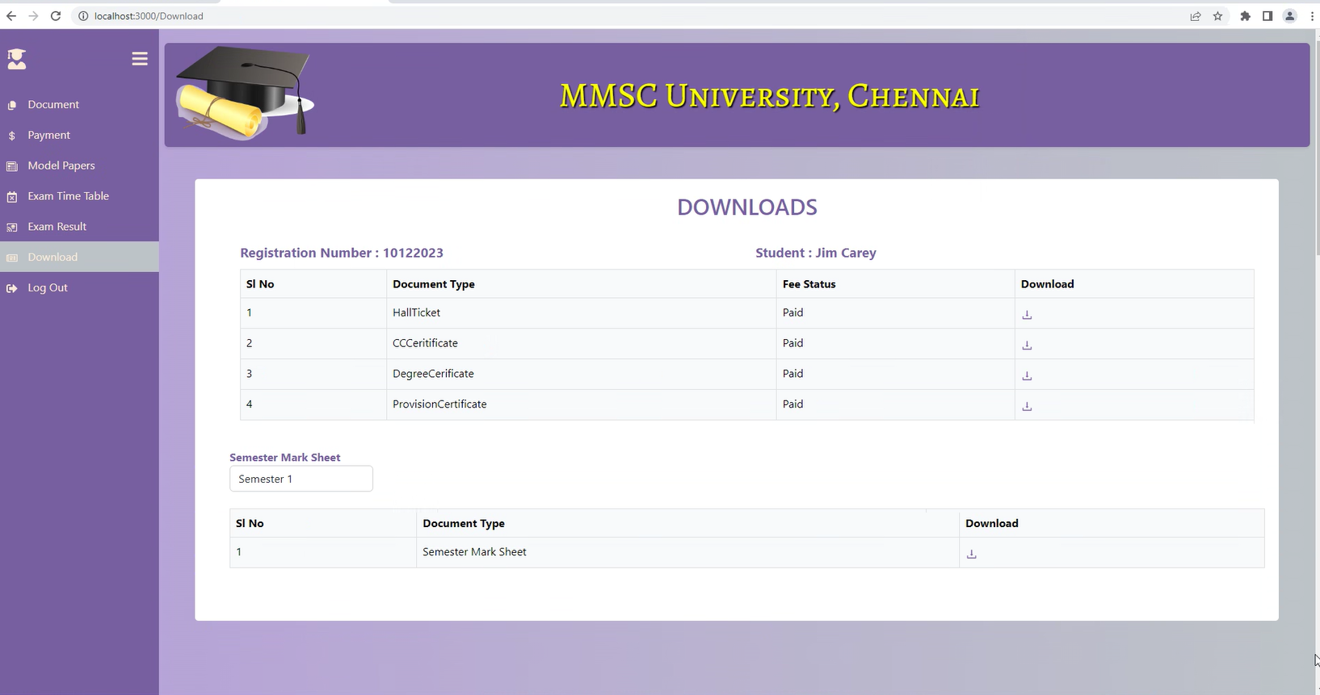
Download

Slide 34

Testcase Link

Slide 35

Future Enhancements
Online examination module would be introduced to conduct online Examination
Further the faculty can upload the videos of their lectures on the Website for the students who had missed those classes can view those videos.

Slide 36

CONCLUSION
The Application provides appropriate information to users according to the chosen service.
The project is designed keeping in view the day to day problems faced by the university and the Students
Deployment of our application will certainly help the college to reduce unnecessary wastage of time in personally going to the University for information
Awareness and right information about any University is essential for both the development of student as well as faculty

Slide 37

Thank you!

